Slide 1



Java basics
Session
3
Chaim Turkel
Ido Barash

Slide 2


Last session
Inheritance
Interfaces
Interface VS Abstract class
casting
Polymorphism

Slide 3
Java basics - 3
Exceptions
Collections interfaces
Iterators

Slide 4

Exceptions
Exception: a irregular behavior that arises during the execution of a program.
Mostly used to handle errors.
Errors can occur due to many reasons
User error
Program error
Physical resources error

Slide 5
Exceptions
Checked exceptions: exceptional scenarios that can be anticipated and maybe recovered from. Has to be handled at compile time. For example: FileNotFoundException
Unchecked exceptions: Runtime exceptions that mostly can be avoiding at programming time. For example: ArrayOutOfBoundException
Errors: problems that arise beyond our control – mostly ignored.

Slide 6







Exceptions
Exceptions hierarchy:
Throwable
Error
Exception
OutOfMemory Error
IOError
IOException
RunTimeException
FileNotFoundExceptions

Slide 7
Exceptions
Exceptions hierarchy:
Throwable
Error
Exception
OutOfMemory Error
IOError
IOException
RunTimeException
FileNotFoundExceptions
Checked exceptions

Slide 8
Exceptions
Exceptions hierarchy:
Throwable
Error
Exception
OutOfMemory Error
IOError
IOException
RunTimeException
FileNotFoundExceptions
unchecked exceptions

Slide 9
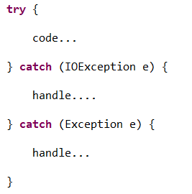
Exceptions
Catch an exception: every Throwable can be caught.
If a method does not handle checked exception it must declare it using the “throws” keyword

Slide 10
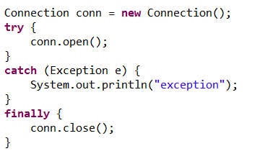
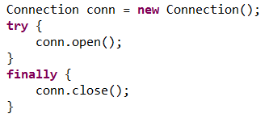
Exceptions
Finally block contains code that will be executed after the executing of the “try” block or the end of the “catch” block.
Finally block will always be executed.
Catch block is not required if you don’t need it.

Slide 11
Exceptions - questions
What is the base class for Error and Exception?
What is the difference between Error and Exception?
If I write return statement in the “try” block, will “finally” block still execute?

Slide 12
Exceptions - questions
What is the base class for Error and Exception?
What is the difference between Error and Exception?
If I write return statement in the “try” block, will “finally” block still execute?
Throwable class

Slide 13
Exceptions - questions
What is the base class for Error and Exception?
What is the difference between Error and Exception?
If I write return statement in the “try” block, will “finally” block still execute?
Throwable class
Error is an irrecoverable situation that occurred during runtime. An exception is a situation you might be able to recover from.

Slide 14
Exceptions - questions
What is the base class for Error and Exception?
What is the difference between Error and Exception?
If I write return statement in the “try” block, will “finally” block still execute?
Throwable class
Error is an irrecoverable situation that occurred during runtime. An exception is a situation you might be able to recover from.
Yes. The finally block will be executed and then the value will be returned.

Slide 15
Collections API
Java provides a nice API to simplify the work with collection of objects.
The Collection API contain a set of classes and interfaces with well defined methods to handle collections of objects.
Basically, These are Java out-of-the-box implementations to known data structures, such as: List, Set, Map, Tree etc…
All collections have no fixed size

Slide 16

Collections API
Java.util.Collection interface
Basic operations:
Entire collection operations :

Slide 17


Collections API
Java.util.List interface
A subtype of the Collection interface
Represents an ordered list objects
Adds the following functionality:
Some implementations:

Slide 18
Collections API
Java.util.List interface – Implementations Performance
List Type | add() | get() | iterate() | size()
Vector | 12.691 | 0.143 | 0.286 | 0.047
Vector with init size | 10.134 | 0.045 | 0.042 | 0.009
ArrayList | 9.873 | 0.051 | 0.037 | 0.013
ArrayList with init size | 9.845 | 0.036 | 0.003 | 0.005
LinkedList | 9.913 | 172.824 | 0.538 | 0.030
Stack | 9.843 | 0.105 | 0.129 | 0.060
CopyOnWriteArrayList | 36.909 | 0.092 | 0.099 | 0.051
The above results are the average performance of 100 runs for a list with size of: 10000 and performing 10000 operations. Therefore each operation was performed 10000 times on each list instance. All time figures listed in this article are in milliseconds.

Slide 19



Collections API
Java.util.Set interface
A subtype of the Collection interface
Represents a collection of object with no duplicates.
Some implementations:

Slide 20
Collections API
Java.util.Set interface
Each object must implement the HashCode for the set to work
public class Employee {
protected long employeeId;
protected String firstName;
protected String lastName;
public int hashCode(){
return (int) employeeId *
firstName.hashCode() *
lastName.hashCode();
}
}
public class Employee {
...
public boolean equals(Object o){
if(o == null) return false;
if(!(o instanceof) Employee) return false;
Employee other = (Employee) o;
return this.employeeId == other.employeeId;
}
}

Slide 21
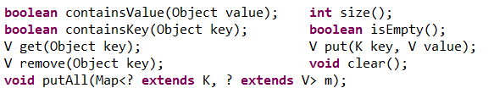

Collection API
Java.util.Map interface
NOT A subtype of the Collection interface
Represents a map between a key and a value
Has the following functionality:
Some implementations:

Slide 22
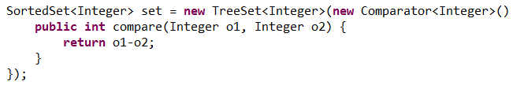
Collections API
Java.util.SortedSet interface
A subtype of the Set interface
Represents an ordered collection of objects with no duplicates.
Uses a class that implements Comparator interface to decide order.
If no Comparator was provided, items are expected to implement Comparable interface.

Slide 23

Collections API
Java.util.Queue interface
A subtype of the Collection interface
Represents an ordered list of object but it allows to add elements only to the end of the list, and removing element only from the beginning of the list.
Adds the following functionality:

Slide 24
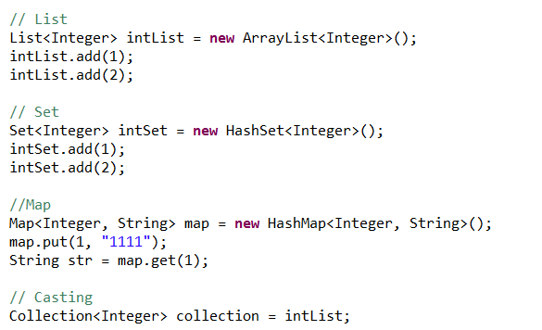
Collections API
Examples:
List is an ordered sequence of elements whereas Set is a distinct list of elements which is unordered

Slide 25
Iterator
An Object the implements either the Iterator interface or the ListIterator Interface.
Iterator can traverse through a collection, obtain or remove elements.
ListIterator extends the Iterator by allowing bi-directional traversing on a collection.
Every collection implementation must provide an iterator for this collection.

Slide 26

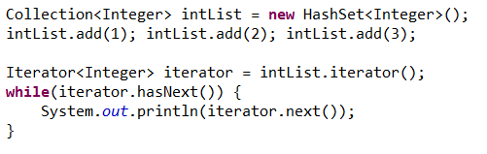
Iterator
The iterator interface provide the following methods:
Using an iterator:

Slide 27

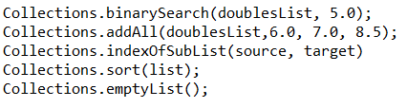
Utility classes
Java provides two useful utility classes to work with collections.
Arrays: Contains static methods to use on arrays:
Collections: Contains static methods to use on collections:

Slide 28
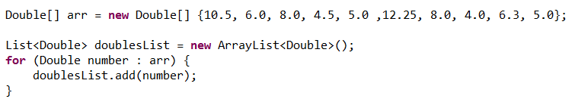
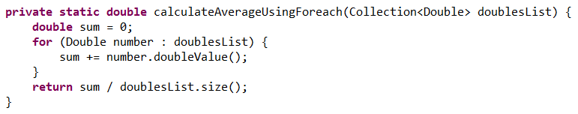
Collections and Iterator
Ex: Create a collection of double items and insert these numbers: 10.5, 6, 8, 4.5, 5,12.25, 8, 4, 6.3, 5 for your convenience:
Write a function to calculate average using for each

Slide 29
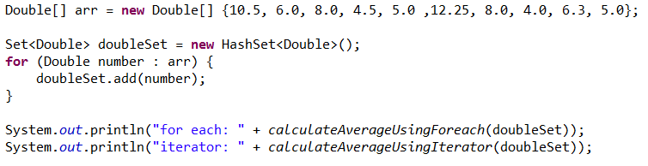
Collections and Iterator
Ex: Create a collection of double items and insert these numbers: 10.5, 6, 8, 4.5, 5,12.25, 8, 4, 6.3, 5
Change the code so every number will be added to the sum only once (do not change methods)

Slide 30
Collections and Iterator
Ex: Create a collection of double items and insert these numbers: 10.5, 6, 8, 4.5, 5,12.25, 8, 4, 6.3, 5
Change the code so every number will be added to the sum only once (do not change methods)

Slide 31
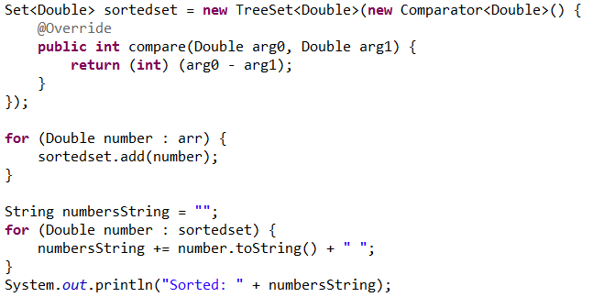
Collections and Iterator
Ex: Create a collection of double items and insert these numbers: 10.5, 6, 8, 4.5, 5,12.25, 8, 4, 6.3, 5
Print the List sorted and without duplicates:

Slide 32
Collections and Iterator
Ex: Create a collection of double items and insert these numbers: 10.5, 6, 8, 4.5, 5,12.25, 8, 4, 6.3, 5
Print the List sorted and without duplicates:

Slide 33
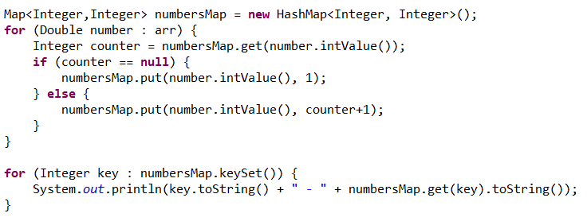
Collections and Iterator
Ex: Create a collection of double items and insert these numbers: 10.5, 6, 8, 4.5, 5,12.25, 8, 4, 6.3, 5
Count how many times a Integer number appears (4 – 2, 10 – 1):

Slide 34
Collections and Iterator
Ex: Create a collection of double items and insert these numbers: 10.5, 6, 8, 4.5, 5,12.25, 8, 4, 6.3, 5
Count how many times a Integer number appears (4 – 2, 10 – 1):

Slide 35
Overview
Exceptions
Collections interfaces
Iterators

Slide 36
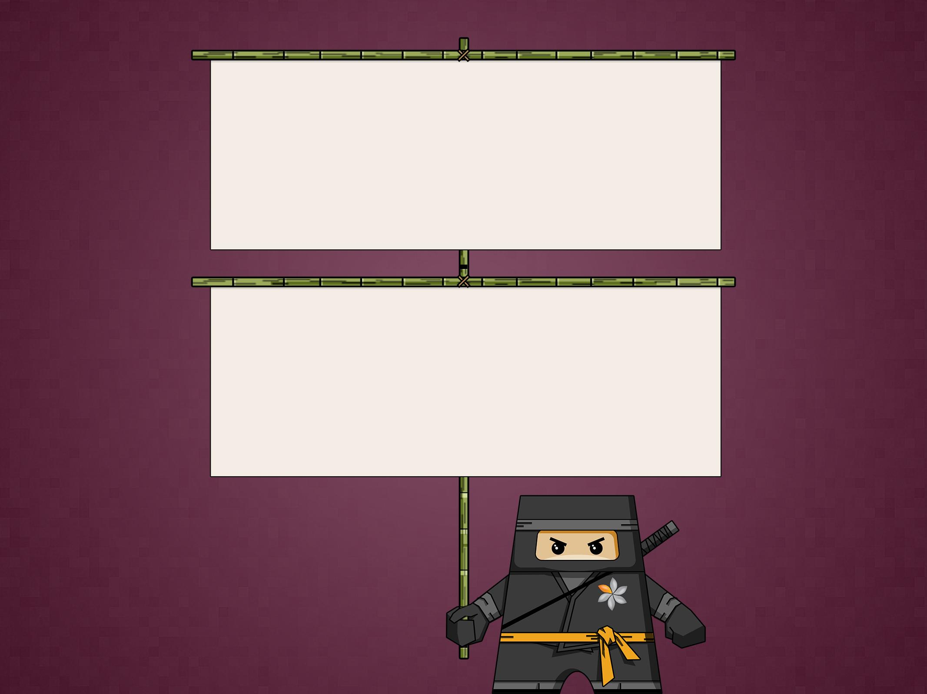
THANK YOU
Chaim Turkel
Email: chaim@tikalk.com

